Slide 1

Solving an SDG Problem with Data
This presentation explores how to leverage data and technology to address a specific problem within a Sustainable Development Goal (SDG). We'll guide you through the process of selecting an SDG, designing a relational database, performing data analysis, and using Microsoft Excel as the user interface.

Slide 2
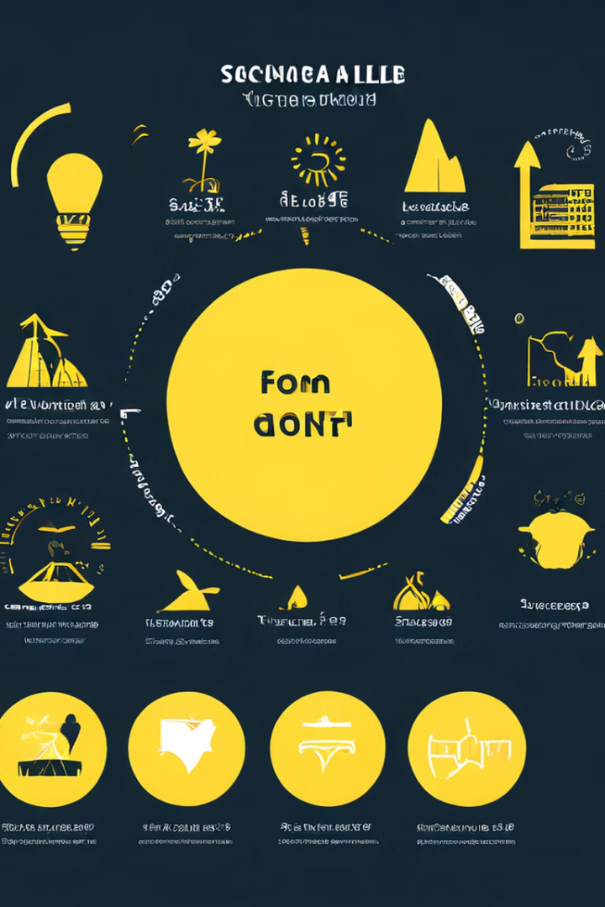
Overview
1
Sustainable Development Goals (SDGs)
2
Data-Driven Solutions
Leveraging data and technology to develop innovative solutions that can effectively tackle SDG-related problems.
17 interconnected global goals adopted by the United Nations to address social, economic, and environmental challenges.
3
Collaborative Approach
Bringing together diverse perspectives and expertise to create impactful, sustainable, and scalable solutions.

Slide 3
Selecting a Sustainable Development Goal
Understanding the SDGs
Choosing Your SDG
Defining the Problem
Review the 17 Sustainable Development Goals and their targets to identify the one that best aligns with your interests and the problem you want to address.
Consider the specific challenges and needs of your local or global community, and select the SDG that you believe you can make the most meaningful impact on.
Clearly define the problem you want to solve within the chosen SDG, and ensure that it is specific, measurable, and impactful.

Slide 4

Designing a Relational Database
Data Identification
1
Identify the relevant data sources and types of information needed to address the problem within your chosen SDG.
2
Data Modeling
Design a relational database structure that efficiently stores and organizes the data, including tables, relationships, and attributes.
Database Implementation
3
Implement the database using a suitable database management system, ensuring data integrity, security, and scalability.

Slide 5
Performing Data Analysis
Data Extraction
Data Transformation
Data Analysis
Develop SQL queries to extract relevant data from the database, ensuring the data is accurate, complete, and up-to-date.
Clean, transform, and prepare the data for analysis, addressing any inconsistencies or missing values.
Analyze the data using statistical techniques, data visualization, and other analytical tools to uncover insights and trends.

Slide 6



Using Microsoft Excel as the User Interface
Database Connection
Data Analysis
Collaboration
Establish a secure connection between Microsoft Excel and the relational database to enable data retrieval and manipulation.
Leverage Excel's powerful data analysis features, such as pivot tables, formulas, and visualizations, to gain insights from the data.
Share the Excel-based user interface with stakeholders, allowing them to interact with the data and contribute to the decision-making process.

Slide 7
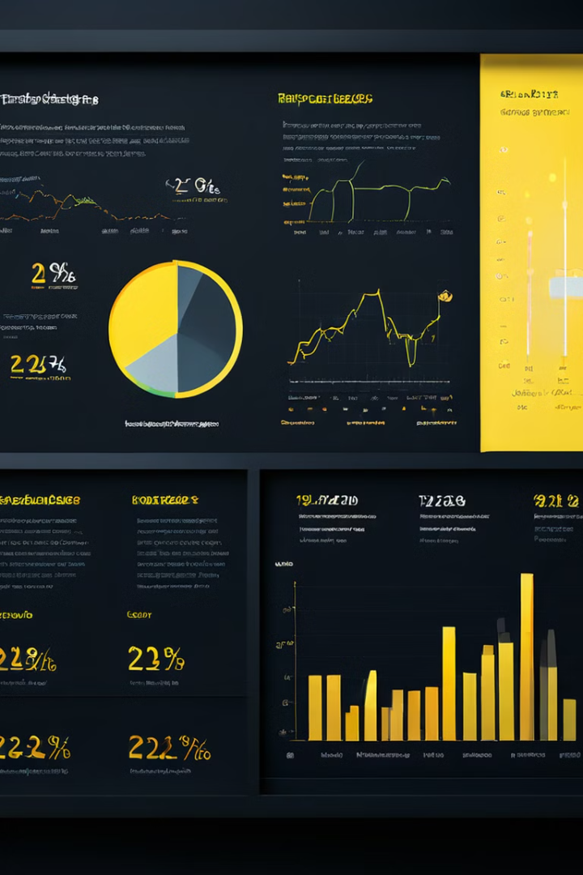
Addressing a Specific Problem within the Chosen SDG
Problem Definition
Data-Driven Approach
Clearly define the specific problem within the chosen SDG that you aim to address through your data-driven solution.
Leverage the data, database, and analysis techniques to develop a comprehensive understanding of the problem and identify potential solutions.
Innovative Solutions
Scalability and Impact
Propose innovative, data-driven solutions that can effectively address the problem and contribute to the achievement of the selected SDG.
Ensure that the proposed solutions are scalable, sustainable, and have the potential to create a significant and lasting impact.

Slide 8
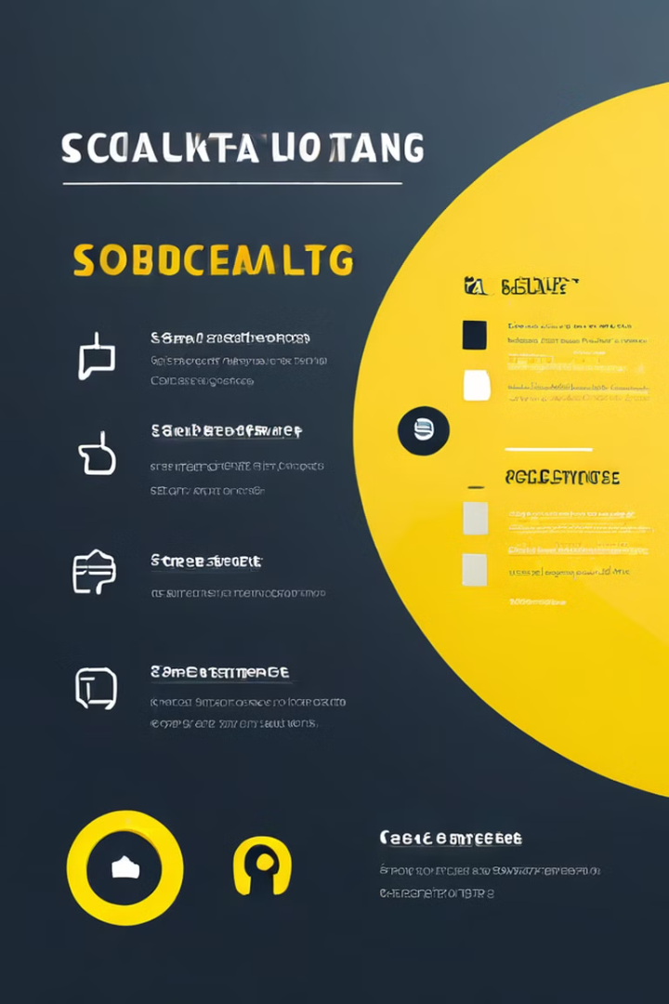
Objectives
1
Select an SDG
2
Design a Database
Choose a Sustainable Development Goal that aligns with your interests and the problem you want to address.
Develop a relational database structure to efficiently store and organize the data needed for your project.
3
Perform Data Analysis
4
Use Excel as the UI
Analyze the data using various techniques to uncover insights and trends relevant to the selected SDG problem.
Leverage Microsoft Excel as the user interface to interact with the database and present the data-driven insights.

Slide 9

Conclusion
By following this process, you can leverage data and technology to develop innovative, scalable, and impactful solutions to address a specific problem within a Sustainable Development Goal. This approach empowers you to make a meaningful contribution to solving global challenges and creating a more sustainable future.

